Slide 1


______________________________________
AMARAVATI CAMPUS
Tentative Title:
Big Data-Driven Machine Learning Models for Smart Grid Stability Prediction
Batch No: 09
P Gagan Devesh(AV.EN.U4AIE22027)
Kabin Dev(AV.EN.U4AIE22015)
D Sai Pardhava Naidu(AV.EN.U4AIE22010)
Balavignesh(AV.EN.U4AIE22016)
Under the guidance of:
Dr. V Lakshmi Chetana
Assistant Professor (Sl. Gr.)
Department of Computer Science and Engineering,
School of Computing

Slide 2
CONTENTS
Introduction
Motivation of Work
Objective of work
Literature Survey
Datasets to be used in your work
References

Slide 3
Introduction
A Smart Grid Stability Analysis system is an AI-driven application that analyzes and predicts the stability of smart grids using machine learning and big data technologies.
The project focuses on preprocessing and analyzing large-scale smart grid data to identify patterns and predict stability.
Technologies used: PySpark, Apache Spark, and Machine Learning Pipelines for scalable data processing and analysis.

Slide 4
Motivation:
The increasing complexity of smart grids requires advanced tools for stability analysis.
Traditional methods struggle with large-scale data processing and real-time analysis.
Improve grid stability prediction accuracy using Big Data and Machine Learning.
Enhance decision-making for grid operators by providing actionable insights.
Reduce downtime and improve efficiency in smart grid operations.

Slide 5
Objectives:
Develop a Smart Grid Stability Analysis system using PySpark and Machine Learning.
Preprocess and analyze large-scale smart grid data for stability prediction.
Implement Feature Engineering and Data Preprocessing pipelines to handle missing values, outliers, and categorical data.
Use Correlation Analysis and Feature Importance techniques to identify key factors affecting grid stability.
Build and evaluate machine learning models for stability prediction.

Slide 6
Literature Survey
Reference | Year of Publication | Datasets used | Description | Limitations of existing work / Research Gaps
[1] Machine Learning Based Energy Management Model for Smart Grid and Renewable Energy Districts. | 2020 | National Renewable Energy Laboratory (NREL) | Proposes a Gaussian Process Regression (GPR)-based ML model combined with Genetic Algorithms (GA) and Particle Swarm Optimization (PSO) to optimize energy surplus, cost, and revenue in renewable energy smart grids, outperforming traditional methods. | Lack in comprehensive ML-based energy management, struggle with stochastic and seasonal variations, lack interpretability, and fail to optimize bidirectional energy flow
[2] Energy Management and Optimization Methods for Grid Energy Storage Systems | 2017 | North American Electric Reliability Corporation (NERC) | Reviews energy management and optimization techniques for grid-scale energy storage systems (ESS), including EMS architectures, BESS applications, and optimization methods like LP and MILP to enhance storage efficiency and grid stability. | Lack real-time energy management, struggle with multi-storage coordination, and fail to optimize energy arbitrage and grid benefits

Slide 7
Reference | Year of Publication | Datasets used | Description | Limitations of existing work / Research Gaps
[3] : Big Data Analytics for Dynamic Energy Management in Smart Grids | 2015 | smart meters and SCADA systems | Explores big data analytics, high-performance computing, and predictive modeling for dynamic energy management (DEM) in smart grids, focusing on real-time power monitoring, load forecasting, and efficient demand response. | Real-time data processing, scalability for large datasets, optimized predictive analytics for load forecasting, and robust data security.
[4] Application of Big Data and Machine Learning in Smart Grid, and Associated Security Concerns: A Review | 2018 | smart meter data, IoT-based sensor data, SCADA system data | Explores big data analytics and machine learning for smart grid management, focusing on IoT integration, cybersecurity, and predictive analytics for stability and efficiency. | Lack real-time processing, robust security, scalability, and full IoT integration in smart grids.

Slide 8
Reference | Year of Publication | Datasets used | Description | Limitations of existing work / Research Gaps
[5] Decentralized Smart Grid Stability Modeling with Machine Learning | 2023 | public dataset with 30,000 data points | Proposes an AI-based approach for decentralized grid stability, evaluating MLP, XGB, SVM, and GP, with XGB performing best. | Lacks real-time control, response efficiency, AI optimization, and participant interaction modeling.
[6] Deep Neural Network-Based Smart Grid Stability Analysis: Enhancing Grid Resilience and Performance | 2024 | University of California’s Machine Learning Repository | Explores the use of machine learning classifiers, including Logistic Regression, XGBoost, Linear SVM, and SVM-RBF, for smart grid stability prediction, with a Deep Neural Network (DNN). | High accuracy in stability prediction but lack real-time adaptability, underutilize deep learning, and lack scalability for large-scale smart grids.

Slide 9
Dataset:
Detailed Description of the Dataset
The dataset used in the study, sourced from the University of California’s Machine Learning Repository, is designed for smart grid stability analysis. It consists of 60,000 rows and 14 features, modeling the interactions between one producer node and three consumer nodes in a four-node star network.
Dataset Overview
Total Records: 60,000 instances
Total Features: 14 (12 independent variables + 2 dependent variables)
Feature Categories:
Reaction Time (τ) [4 features] – Measures how fast a producer or consumer responds to changes in energy supply/demand.
Total Power Balance (P) [4 features] – Indicates whether energy is being produced or consumed.
Price Elasticity Coefficient (γ) [4 features] – Represents energy price elasticity for each grid participant.
Stability Labels [2 dependent features] – Defines whether the grid is stable or unstable.

Slide 10
2. Structure of the dataset:
The dataset represents a four-node star network, which includes:
1 Producer Node (P1) – Generates electricity and interacts with consumers.
3 Consumer Nodes (P2, P3, P4) – Consume electricity based on demand and price elasticity.
Stability is determined based on the interactions between production, consumption, and reaction times.
Key Insights:
Reaction time (τ) is most influential in determining stability, as slower response times can lead to instability.
Power balance (P) impacts whether a node is supplying or consuming energy.
Price elasticity (γ) affects market-driven adjustments in electricity distribution.
3. Stability Labeling Criteria:
The dataset provides two stability indicators:
stab (numeric stability value)
Positive stab value → Unstable grid
Negative stab value → Stable gridstabf (binary stability label)
"stable" (1) → Grid is operating normally.
"unstable" (0) → Grid faces disruptions or power fluctuations.
The labeling is done based on the differential equation-based decentral smart grid control model, which evaluates the system's behavior under different conditions.

Slide 11
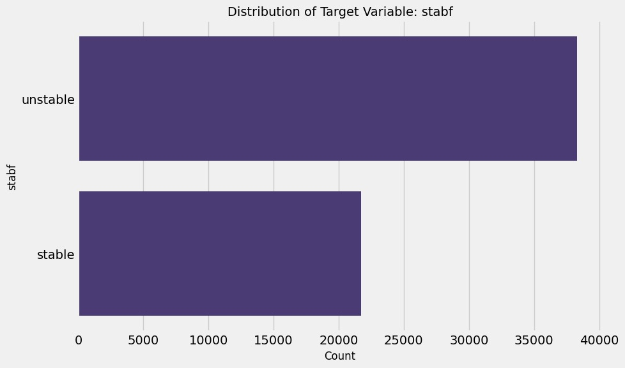
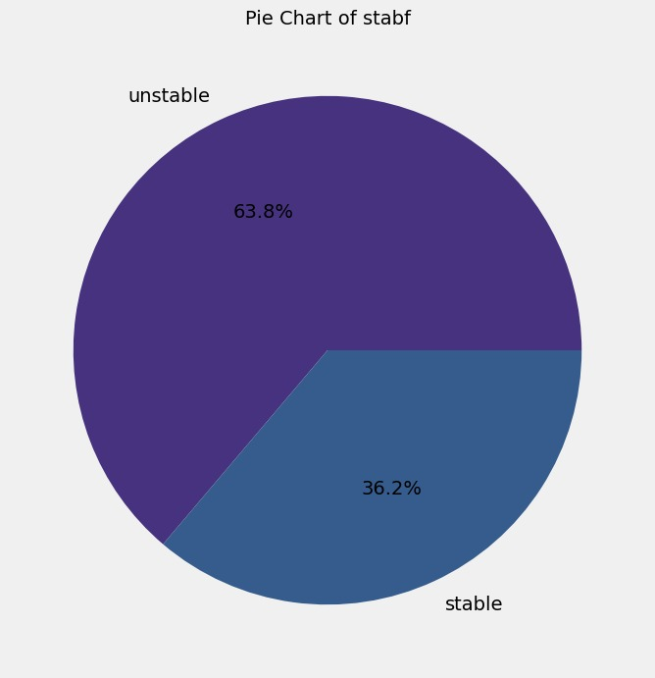
Data Visualization:

Slide 12
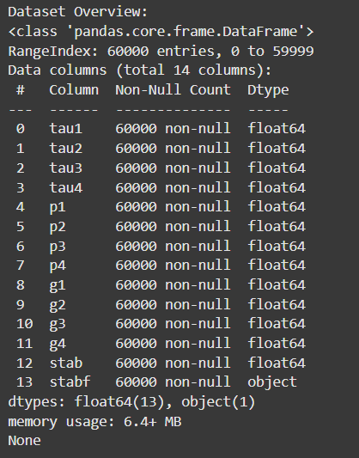
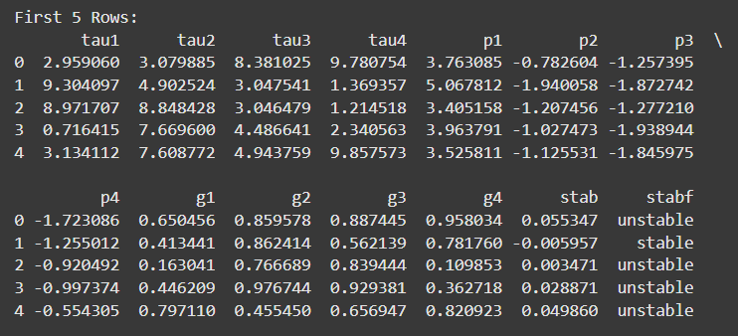

Slide 13
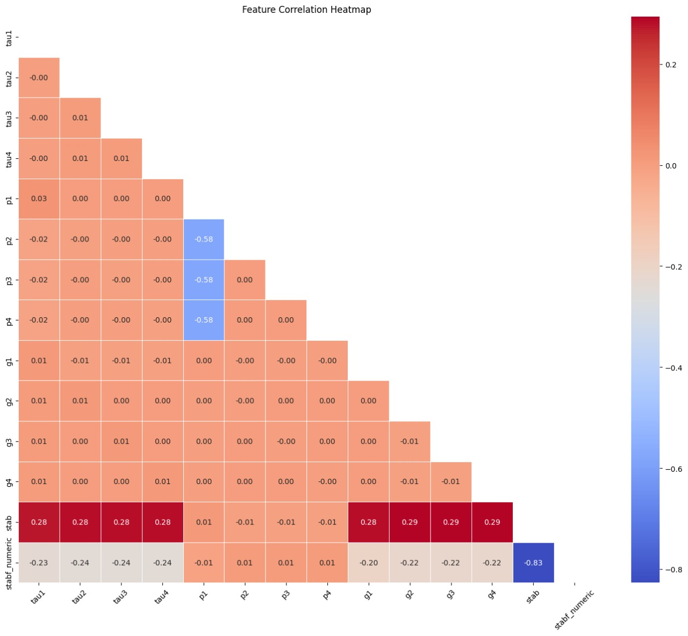

Slide 14
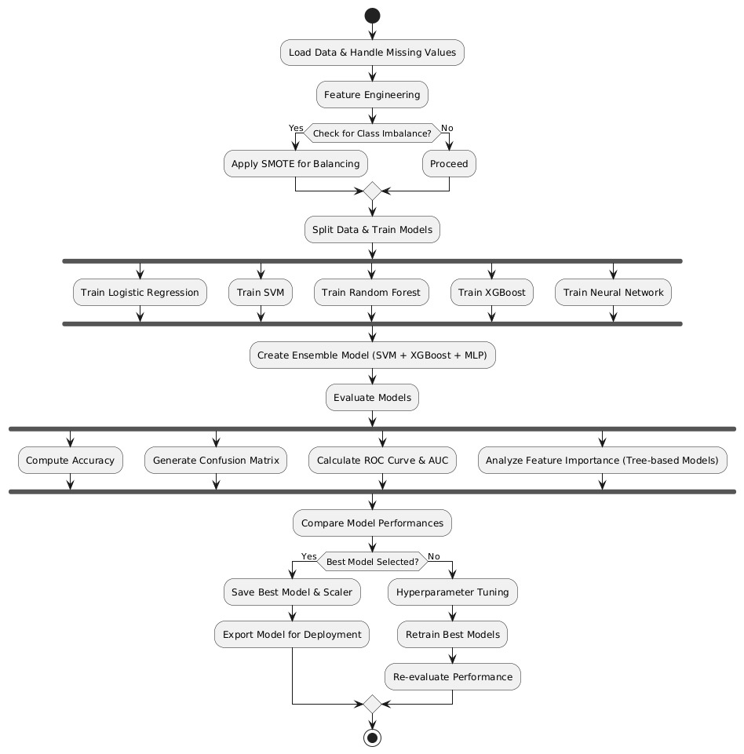

Slide 15
Data preprocessing
Separate numerical and categorical features for processing.
Convert categorical values into numerical representations. Normalize or standardize numerical features. Combine processed features into a structured format for model training.
Execute the preprocessing steps on the dataset.
Display the transformed data, ready for model training.

Slide 16
References
[1] Title: Machine Learning Based Energy Management Model for Smart Grid and Renewable Energy Districts.
Link: Click Here
[2] Title: Energy Management and Optimization Methods for Grid Energy Storage Systems
Link: Click Here
[3] Title: Big Data Analytics for Dynamic Energy Management in Smart Grids
Link: Click Here
[4] Title: Application of Big Data and Machine Learning in Smart Grid, and Associated Security Concerns: A Review
Link: Click Here
[5] Title: Decentralized Smart Grid Stability Modeling with Machine Learning Link: Click Here
[6] Title: Deep Neural Network-Based Smart Grid Stability Analysis: Enhancing Grid Resilience and Performance
Link: Click Here

Slide 17
Thank you!

